Slide 1
Linear and Multiple Linear Regression
Submitted by
Sampada Kharel : 191724
Subina Maharjan : 191734
Reviewed by
Sristi Ghimire , Apsara BK ,Menuka Lamsal,Hansika Jha

Slide 2
Contents
Introduction to linear regression
Application of linear regression
Algorithm of linear regression
Introduction to multiple linear regression
Assumption of multiple linear regression
How to perform multiple linear regression
Limitation of multiple linear regression

Slide 3
Regression
Regression is a statistical method.
Is relationship between a dependent variable and one or more independent variables.
To understand how the independent variables are related to the dependent variable.

Slide 4
Linear Regression
It is statistical method used to model the linear relationship between Dependent variable and one or more independent variables.
Modeled using a linear equation of the form
y = mx + b , where
y =dependent variable
x =independent variable
m=slope of the line and
b= y-intercept.
The goal is to find the values of m and b that best fit the data.

Slide 5
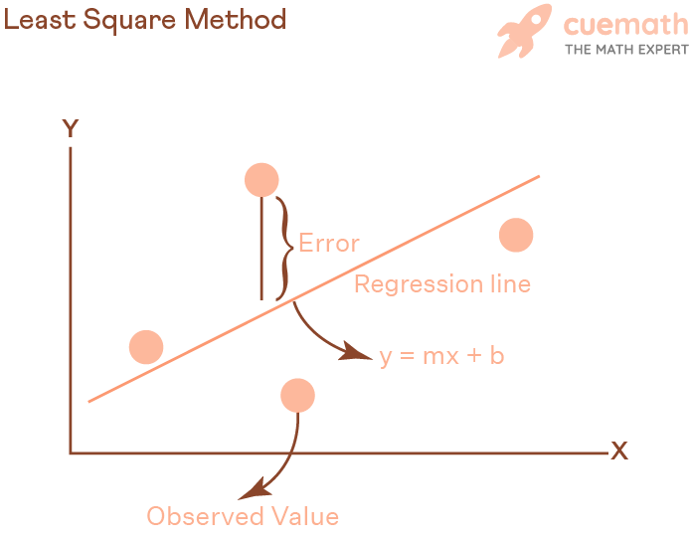
Least square method:
The least squares method is a statistical technique.
Used to find the best-fitting line through a set of data points.
Common method used in linear regression.
To estimate the values of the slope (m) and y-intercept (b) in the equation y = mx + b.

Slide 6
Algorithm
Collect a set of data points (X, Y), where X is the independent variable and Y is the dependent variable.
Calculate the mean of X and Y.
Calculate the coefficients b1 and b0 using the following formulas:
b1 = Σ((X - mean(X)) * (Y - mean(Y))) / Σ(X - mean(X))^2
b0 = mean(Y) - b1 * mean(X)
The line of best fit is represented by the equation Y = b0 + b1X
Finally, use this equation to make predictions for new data points.

Slide 7
Applications
Some area of applications of linear regression include,
Economics
Finance
Medicine
Marketing
Engineering

Slide 8
Multiple Linear Regression
Is a relationship between multiple independent variables and a single dependent variable
Extension of simple linear regression
Represented by an equation with multiple predictor variables
Minimize the difference between the predicted values and actual values
Coefficients can be used to make predictions

Slide 9
Assumption of multiple linear regression
Homogeneity of variance
Independence of observations
Normality
Linearity
Notes:
H

Slide 10
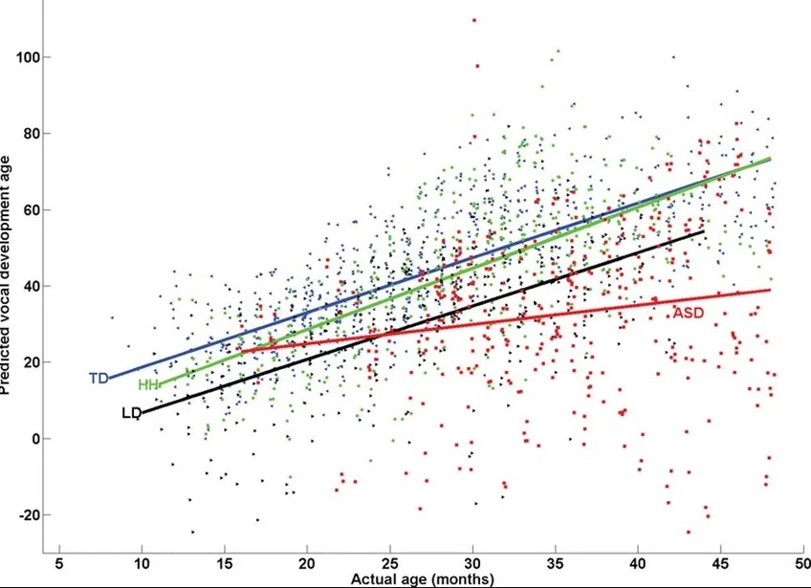
Graph of Multiple Linear Regression
Always linear
Actual age vs pred. Dev.age

Slide 11
How to perform multiple linear regression
The formula for multiple linear regression is
y = b0 + b1x1 + b2x2 + … + bn*xn
Where,
y is the dependent variable
b0 is the y-intercept
b1,b2,...,bn are the coefficients
x1,x2,...,xn are the independent variables

Slide 12
Limitations of multiple linear regression
Linearity assumption
Independence assumption
Normality assumption
Limited to small number of independent variables
Limited to linear relationship

Slide 13
Conclusion
Linear regression is used for only one independent variable
Multiple regression is used for more than one independent variable
Powerful tool for predicting the relationship between variables
Goal is to find the coefficient that minimizes the relationship between the predicted value and actual value

Slide 14
Reference
From java point

